Slide 1
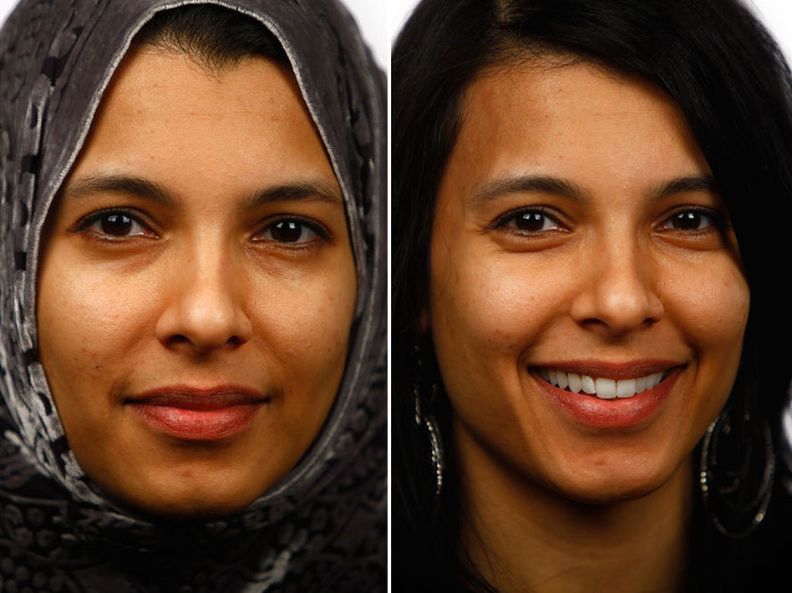
Why Muslim Women Do Not Wear the Hijab

Slide 2
The Aftermath of 9/11
A lot of the prejudice directed at Muslims after the terrorist events of 9/11 scared a lot of Muslim women
Some Muslim women also found it a painful reminder of what some extremists had done
They did something horrible and claimed it in the name of Islam

Slide 3
The Pressure of being a Spokeswoman
Some women did not like being constantly associated with Islam
They wanted to be free to just be themselves rather than labeled as a Muslim woman
Some women did not want to have to constantly defend their religion to other people
Makes it almost impossible to “blend in” to society

Slide 4
Embracing their Beauty
Wanted the chance to embrace their own natural beauty
Wanted to feel comfortable in their own skin
Strangers often noticed the hijab before they noticed the woman wearing it
Some women felt themselves becoming too judgmental of other women who were not

Slide 5
Too Much Emphasis on Clothing
Many women felt that the focus was becoming too much on the hijab and less on the actual faith of the individual
Some felt that it actually hindered spiritual growth
Women were wearing the hijab out of fear/obligation rather than by choice
Women who took it off had to engage in much more critical religious thinking and spiritual growth to reach a decision

Slide 6
Unspoken Meanings
In the world we live in today, lot of political and social messages are sent and received by the hijab

Slide 7
In Their Own Words
Click the link below to listen to some women talk about their decision to take the hijab off
Click here to watch the video

