Slide 1
Temple Mount
Primary Document Questions

Slide 2
Document Questions
Tips for studying and analyzing documents:
Start by studying the document to see if it is a PRIMARY document or a SECONDARY document.
Establish a context for each document: WHEN, WHERE & WHO the document is about.
Determine the AUTHOR or creator of each document.
Determine the INTENDED AUDIENCE for each document.
Decide if AUTHOR or AUDIENCE could create a bias in the document.

Slide 3
Document Set 1: Maps The Temple Mount is located in Jerusalem, Israel.

Slide 4
Religions in the Middle East / Southwest Asia
Turkey
Syria
Iran
Israel
Iraq
Jordan
Egypt
Saudi
Arabia

Slide 5
Document 2: Dome of the Rock

Slide 6
Document 3: Dome of the Rock Background
“The Dome of the Rock is a 7th-century edifice (shrine) located in Jerusalem. It enshrines the rock from which Muhammad is said to have ascended to heaven. Sometimes erroneously called the Mosque of Umar, from a tradition that it was built by Caliph Umar I, the Dome of the Rock was actually built by Caliph (leader) Abd al-Malik between 687 and 691.”
From domeoftherock.net

Slide 7
Dome of the Rock, continued
“The Dome of the Rock is located on a rocky outcrop known as Mount Moriah, where, according to Jewish belief, Abraham offered his son Isaac as a sacrifice. The inscriptions inside the building glorify Islam as the final true revelation and culmination of the faiths of Judaism and Christianity. The building is actually not a mosque but a ciborium, erected over a sacred site. According to later Islamic tradition, the Rock (al-Sakhra) in the midst of the building was the spot from which Mohammed ascended to heaven after his miraculous night journey from Mecca to Jerusalem on the winged steed al-Buraq.”
From domeoftherock.net

Slide 8
Document 4: Story of Abraham’s Sacrifice
The story of Abraham is told in the the Jewish Pentateuch, the Christian Bible and the Islamic Qur’an, since Abraham is considered to be the ”father” or founder, of all three religions.
The following story of Abraham’s sacrifice, is a central narrative in all three religions.
Many Jewish followers and scholars believe that the sacrifice took place on Mount Moriah, the site of the modern day Dome of the Rock.

Slide 9
Story of Abraham’s Sacrifice
Genesis 22, New International Version (NIV)
2 Then God said, “Take your son, your only son, whom you love—Isaac—and go to the region of Moriah. Sacrifice him there as a burnt offering on a mountain I will show you.”
3 Early the next morning Abraham got up and loaded his donkey. He took with him two of his servants and his son Isaac. When he had cut enough wood for the burnt offering, he set out for the place God had told him about. 4 On the third day Abraham looked up and saw the place in the distance. 5 He said to his servants, “Stay here with the donkey while I and the boy go over there. We will worship and then we will come back to you.”
6 Abraham took the wood for the burnt offering and placed it on his son Isaac, and he himself carried the fire and the knife. As the two of them went on together, 7 Isaac spoke up and said to his father Abraham, “Father?”
“Yes, my son?” Abraham replied.
“The fire and wood are here,” Isaac said, “but where is the lamb for the burnt offering?”
8 Abraham answered, “God himself will provide the lamb for the burnt offering, my son.” And the two of them went on together.

Slide 10
9 When they reached the place God had told him about, Abraham built an altar there and arranged the wood on it. He bound his son Isaac and laid him on the altar, on top of the wood. 10 Then he reached out his hand and took the knife to slay his son. 11 But the angel of the Lord called out to him from heaven, “Abraham! Abraham!”
“Here I am,” he replied.
12 “Do not lay a hand on the boy,” he said. “Do not do anything to him. Now I know that you fear God, because you have not withheld from me your son, your only son.”
13 Abraham looked up and there in a thicket he saw a ram[a] caught by its horns. He went over and took the ram and sacrificed it as a burnt offering instead of his son. 14 So Abraham called that place The Lord Will Provide. And to this day it is said, “On the mountain of the Lord it will be provided.”
15 The angel of the Lord called to Abraham from heaven a second time 16 and said, “I swear by myself, declares the Lord, that because you have done this and have not withheld your son, your only son, 17 I will surely bless you and make your descendants as numerous as the stars in the sky and as the sand on the seashore. Your descendants will take possession of the cities of their enemies, 18 and through your offspring[b] all nations on earth will be blessed,[c] because you have obeyed me.”

Slide 11
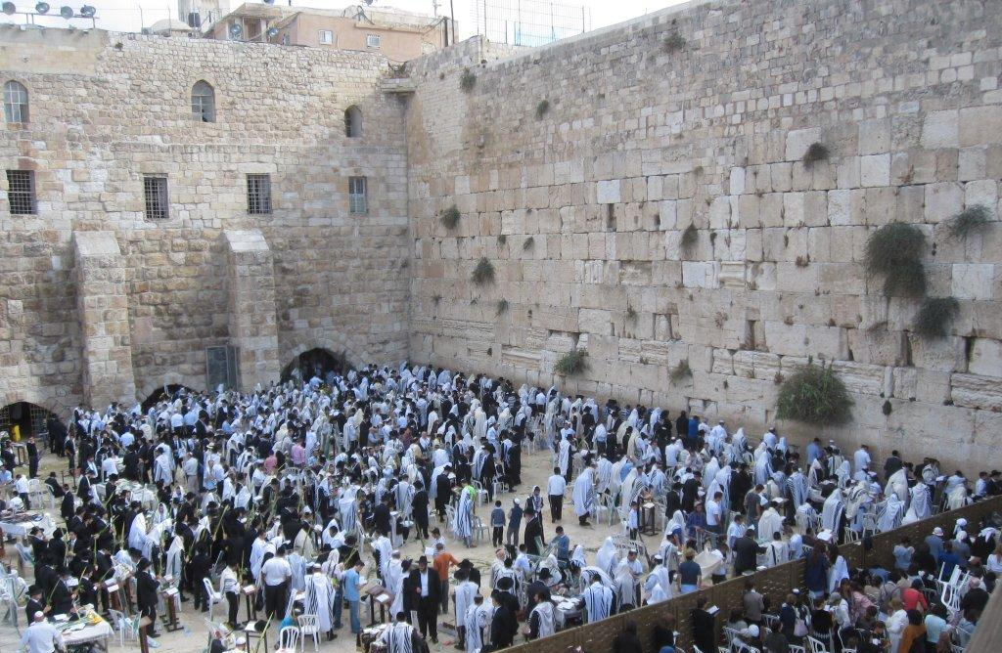
What is the Western Wall?

Slide 12
Document 5: Western Wall
“When Rome destroyed the Second Temple in 70 C.E., only one outer wall remained standing. The Romans probably would have destroyed that wall as well, but it must have seemed too insignificant to them; it was not even part of the Temple itself, just an outer wall surrounding the Temple Mount. For the Jews, however, this remnant of what was the most sacred building in the Jewish world quickly became the holiest spot in Jewish life. Throughout the centuries Jews from throughout the world made the difficult pilgrimage to Palestine, and immediately headed for the Kotel ha-Ma'aravi (the Western Wall) to thank God. The prayers offered at the Kotel were so heartfelt that gentiles began calling the site the “Wailing Wall.” This undignified name never won a wide following among traditional Jews; the term “Wailing Wall” is not used in Hebrew.”
Copyright American-Israeli Cooperative Enterprise - Reprinted with permission.
http://www.jewishvirtuallibrary.org/jsource/Judaism/Western_Wall.html

Slide 13
Western Wall, continued
“The custom of inserting written prayers into the Kotel's cracks is so widespread that some American-Jewish newspapers carry advertisements for services that insert such prayers on behalf of sick Jews. The mystical qualities associated with the Kotel are underscored in a popular Israeli song, a refrain of which runs: “There are people with hearts of stone, and stones with hearts of people.” A rabbi in Jerusalem once told me that the Hebrew expression “The walls have ears” was originally said about the Western Wall.”
Copyright American-Israeli Cooperative Enterprise - Reprinted with permission.
http://www.jewishvirtuallibrary.org/jsource/Judaism/Western_Wall.html

Slide 14
2013 Photo of the Western Wall (foreground) with Dome of the Rock (background on left)

Slide 15
Document 6: Church of Holy Sepulchre
”In approximately 33 AD, Jesus of Nazareth was condemned to death, crucified on Mount Golgotha and buried in a tomb that had been excavated in a nearby garden. After three days he rose from the dead. From this moment the Tomb of the Resurrection became the central place of faith for all Christianity. “
When Constantine converted the Roman empire to Christianity…
"the venerated tomb was brought to light and the magnificent complex of the Holy Sepulchre was inaugurated in 335 AD."
http://www.holysepulchre.custodia.org/default.asp?id=4072

Slide 16
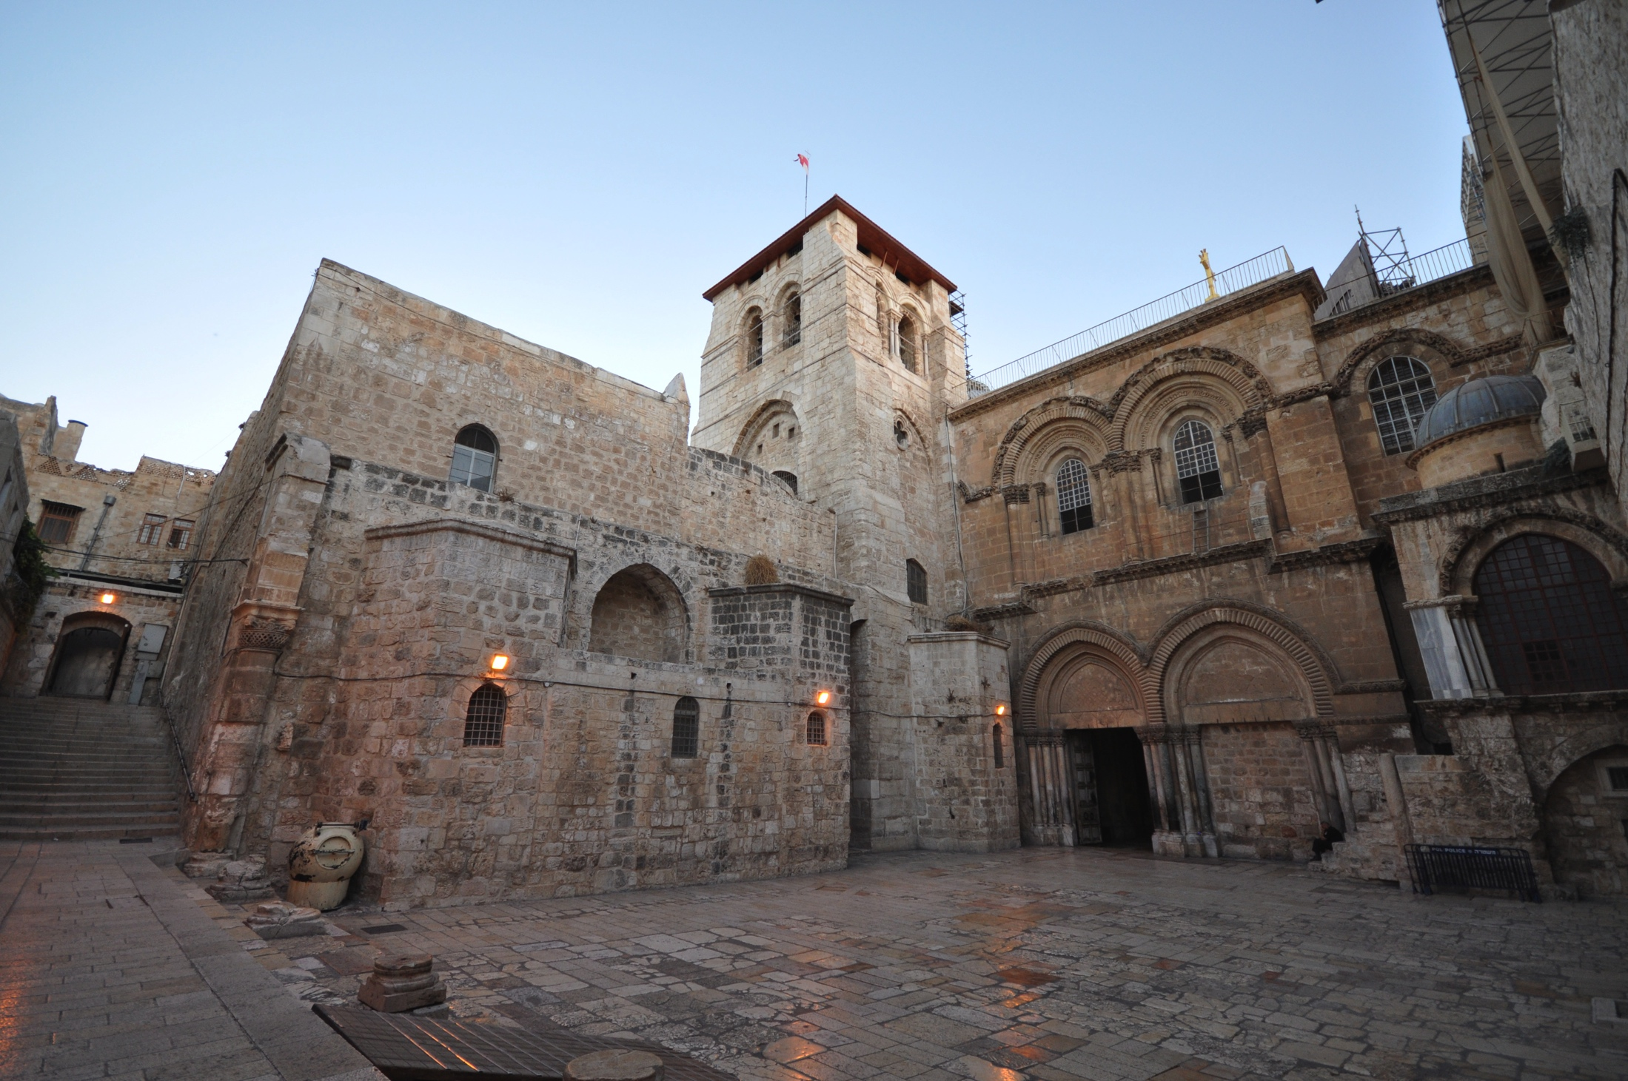
Church of Holy Sepulchre
Photo from Wikimedia Commons, author http://www.flickr.com/photos/jlascar/

Slide 17
Document 7: Timeline
Read the entire timeline, considering how
Jerusalem changed hands between religions multiple times throughout history.
* The Temple of Jerusalem was built by believers of Jewish religion.

Slide 18
1738 B.C.E.
Abraham goes to Jerusalem, begins Jewish religion.
638 C.E.
Muslims conquer Jerusalem. Jews allowed to return to Jerusalem.
Dome of the Rock shrine built on site of 2nd Temple.
352 B.C.E.
2nd Temple built
70 C.E.
Destruction of 2nd Temple by Romans. All that is left standing is the Western Wall of the Temple.
825 B.C.E.
1st Temple of Jerusalem built by Solomon
0
423 B.C.E.
Destruction of 1st Temple by Babylonians
312 C.E.
Christians expel Jewish people from Jerusalem
1676 B.C.E.
Abraham’s sacrifice

Slide 19
1009 C.E.
Arab leader Caliph al-Hakim destroys the structure built by Constantine.
1244 C.E.
Jerusalem is once again under Muslim control, Christians retain control of the Church of Holy Sepulchre.
0
1099 C.E.
Christian crusaders conquer Jerusalem (taking it from Muslim powers),
1948 C.E.
Israel is established (a primarily Jewish country). Many Muslim Palestinians are expelled from country.

Slide 20
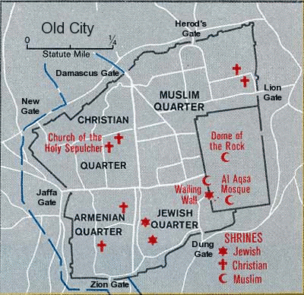
Document 8: Map of the Old City
From:
http://wikitravel.org
Key

