Slide 1
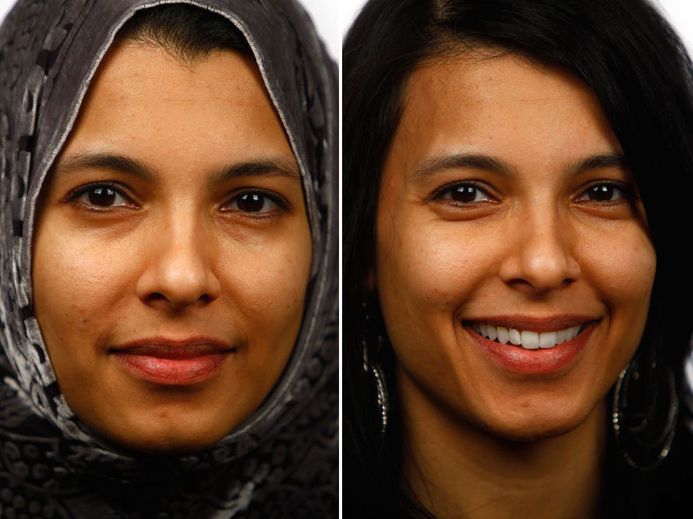
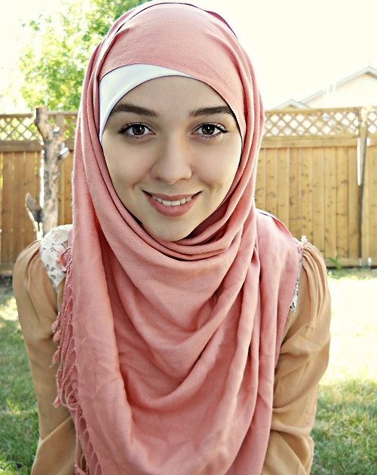
Western Views of the Hijab

Slide 2
Controversy
There are constant debates going on in Western societies over the meaning of the hijab, the purposes, and the dangers of wearing it.
Some countries in Europe have banned the wearing of hijabs in public places

Slide 3
Source of Prejudice
For men and women who are prejudice against Muslims, the hijab is a symbol of the Islamic faith and also points out who is a Muslim and who is not.
58% of the attacks on Muslims are done on Muslim women.
80% of Muslim women who were attacked were wearing the hijab

Slide 4
Oppression
Many non-Muslims see the hijab as a symbol of the oppression of Muslim women
Many non-Muslims do not realize that women are given a choice to wear the hijab or not
Often seen as showing that the bodies do not belong to the women, but to the men.
Believe that Muslim women are not given the chance to enjoy their beauty

Slide 5
An Opportunity for Learning
Many non-Muslims do not know much about the faith of Islam, or the hijab.
When Muslim women began saying that they chose to wear the hijab and what they hijab truly means in Islam, non-Muslims became interested
Westerners are becoming much more open to learning the true meaning of the hijab and recognizing its significance

Slide 6
Experience it for yourself
Click the link below to watch a video showing the reactions of several non-Muslims who were given the opportunity to try on a hijab
Click here to watch the video

