Slide 1
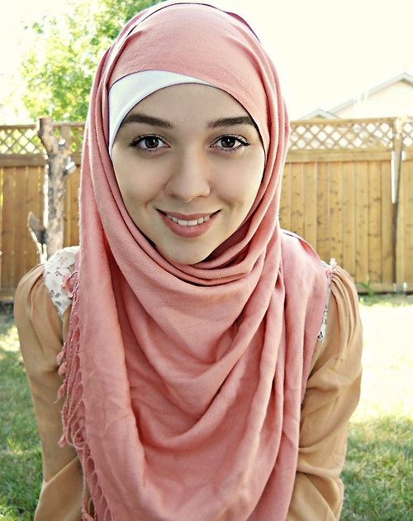
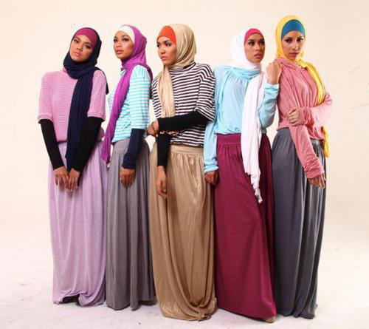
Why Muslim Women Do Wear The Hijab

Slide 2
Identity
For many Muslim women, the hijab is a source of identity
Strangers know who these women are before they even meet
It shows pride in their faith.

Slide 3
Following the Quran
“And say to the believing women that they should lower their gaze and guard their modesty; that they should not display their beauty and ornaments except what (must ordinarily) appear thereof; that they should draw their veils over their bosoms and not display their beauty except to their husbands, or small children; and that they should not strike their feet in order to draw attention to their hidden ornaments. And O ye believers! Turn ye all together towards Allah, that ye may attain Bliss” 24:31

Slide 4
Following the Quran
Many Muslims point to the Quran calling for both men and women to dress and behave modestly.
For many Muslims modest dress for women means wearing the hijab
Quran is open to interpretation, which is why some Muslims do not believe that wearing the hijab is mandatory

Slide 5
Spiritual Growth
A symbol of piety, modesty, and religious obedience
Some Muslim women believe that it helps them stay away from anything that would inhibit their faith
Drinking, drugs, acting immodestly
Many feel that it brings them closer to God

Slide 6
A symbol of respect
Many Muslim women feel that the Hijab leads to more respect- from both themselves and other people
It forces people to get to know them as a person and focus on their character and intelligence, rather than beauty.

Slide 7
A new kind of beauty
Women who wear the hijab often say they feel free from the obsession with beauty and image that is so common in the West.
Wearing a hijab, especially in western countries, requires a lot of confidence
Non-Muslims often do not understand and react in negative ways
Many Muslims believe that wearing the hijab frees women to focus on inner spiritual beauty rather than external beauty.

Slide 8
In their own Words
Click to Watch video
Watch the video clip above to hear some Muslim women talk about what the hijab means to them in celebration of World Hijab Day which was on February 1, 2014

